Slide 1

Christmas WebQuest
Name: _____________ Period: _______
Name: _____________
December’s Cultural Awareness Project
The History of Christmas Tree – /15 pts
The History of Christmas – /30 pts
Christmas Traditions Research – /18 pts
Venn Diagram – /15 pts
Fun Page /12 pts
Cleanliness & Responsibility /10 pts
Total: /100 pts Grade:

Slide 2
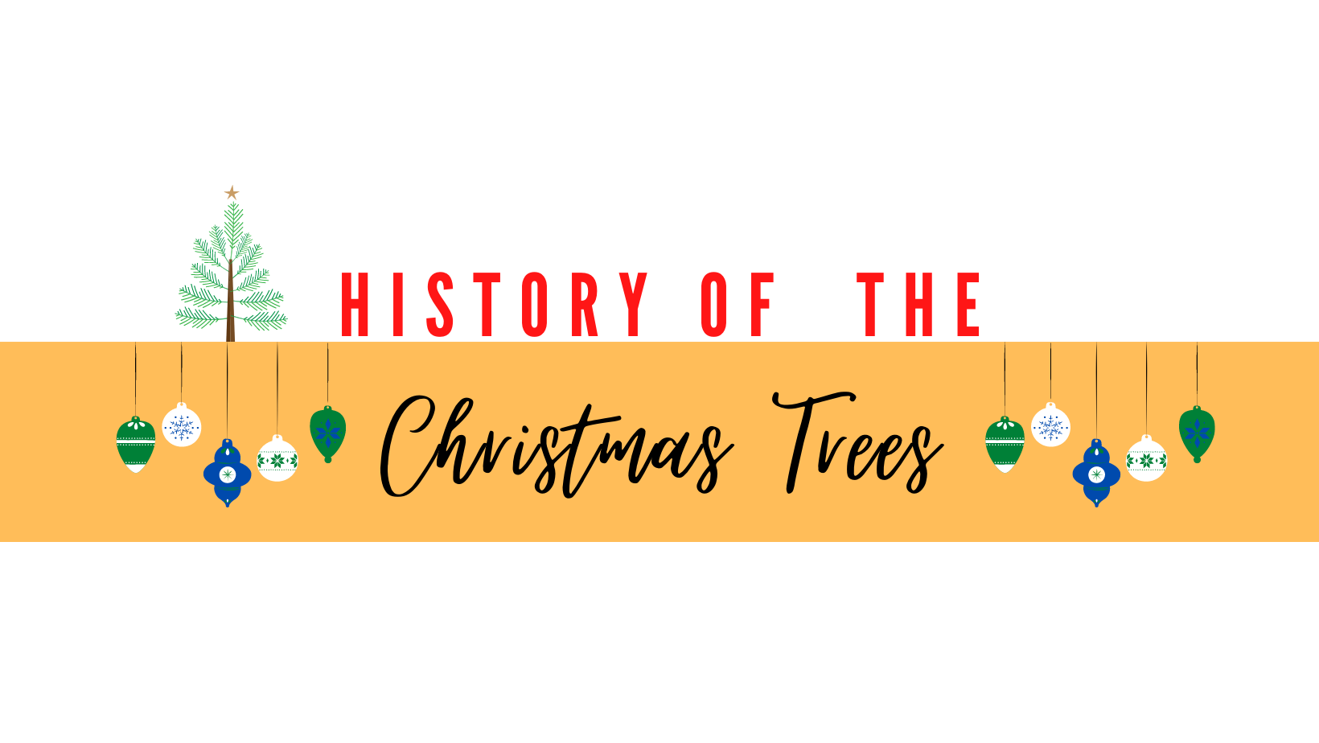
© Mrs.K. Cruz
Name: Period: Date:
Instructions: Use https://www.whychristmas.com/customs/christmas-trees#started to answer the following questions. These questions are in the section “How Christmas Trees Started“.
Why did pre-Christian and pagan cultures use evergreen branches during the winter solstice?
How were Fir trees used in the Roman festival of Saturnalia?
What were “Paradise Trees,” and what role did they play in medieval German plays?
How did the decorations on early Christmas trees evolve during the late 1400s and 1500s in Germany?
Why were some Christmas trees or branches hung from ceilings in certain European countries?

